Slide 1
Production or Expert Systems

Slide 2
Weaknesses of Expert Systems
Require a lot of detailed knowledge
Restrict knowledge domain
Not all domain knowledge fits rule format
Expert consensus must exist
Knowledge acquisition is time consuming
Truth maintenance is hard to maintain
Forgetting bad facts is hard

Slide 3
Rule-Based Systems
Also known as “production systems” or “expert systems”
Rule-based systems are one of the most successful AI paradigms
Used for synthesis (construction) type systems
Also used for analysis (diagnostic or classification) type systems

Slide 4
Rule Format
Label R_{n} if condition1
condition2
…
then
action1
action2
…

Slide 5
Generic System Components
Global Database
  content of working memory (WM)
Production Rules
  knowledge-base for the system
Inference Engine
  rule interpreter and control subsystem

Slide 6
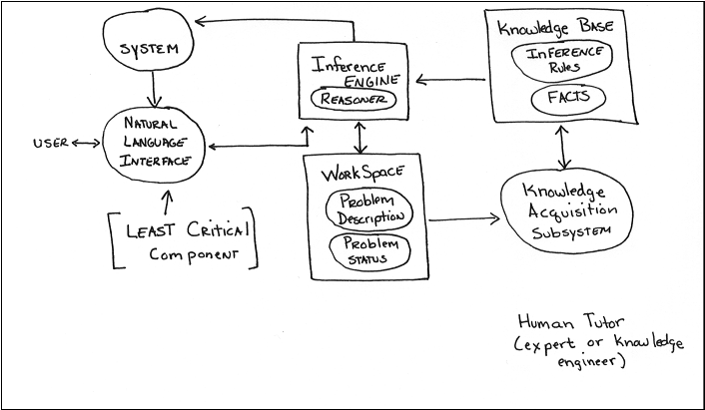
Expert System Architecture
Explanation

Slide 7
Forward Chaining Procedure
Do until problem is solved or no antecedents match
  Collect the rules whose antecedents are found in WM.
  If more than one rule matches
    use conflict resolution strategy to eliminate all but one
  Do actions indicated in by rule “fired”

Slide 8
Inference Engine
Rulebase
new rule
Conflict
Resolution
Execute
Match
new fact
Factbase

Slide 9
Conflict Resolution Strategies
Specificity or Maximum Specificity
  based on number of antecedents matching
  choose the one with the most matches
Physically order the rules
  hard to add rules to these systems
Data ordering
  arrange problem elements in priority queue
  use rule dealing with highest priority elements
Recency Ordering
  Data (based on order facts added to WM)
  Rules (based on rule firings)

Slide 10
Conflict Resolution Strategies
Context Limiting
  partition rulebase into disjoint subsets
  doing this we can have subsets and we may also have preconditions
Execution Time
Fire All Application Rules

Slide 11
Bagger
An expert system to bag groceries
Check order to see if customer has forgotten something.
Bag large items with special attention to bagging big bottles first.
Bag medium items with special handling of frozen foods.
Bag small items putting them wherever there is room.

Slide 12
Bagger
For set of rules see the handout
The conflict resolution strategy
  Maximum specificity
    (can be simulated by careful rule ordering)
  Context Limiting
    (needs to set and evaluate context variable)

Slide 13
Rule B1
  IF step is check-order
  there is bag of potato chips
  there is no soft drink bottle
  THEN add one bottle of Pepsi to order
Rule B2
  IF step is check-order
  THEN discontinue check-order-step
  start bag-large-items step
Rule B3
  IF step is bag-large-items
  there is large item to be bagged
  there is large bottle to be bagged
  there is bag with less than 6 large items
  THEN put large item in bag

Slide 14
Rule B4
  IF step is bag-large-items
  there is large item to be bagged
  there is bag with less than 6 large items
  THEN put large item in bag
Rule B5
  IF step is bag-large-items
  there is large item to be bagged
  THEN start fresh bag
Rule B6
  IF step is bag-large-items
  THEN discontinue bag-large-items
  start bag-medium-items step

Slide 15
Rule B7
  IF step is bag-medium-items
  there is medium item to be bagged
  there is empty bag or bag with medium items
  bag is not yet full
  medium item is frozen
  medium item is not in freezer bag
  THEN put medium item in freezer bag
Rule B8
  IF step is bag-medium-items
  there is medium item to be bagged
  there is empty bag or bag with medium items
  bag is not yet full
  THEN put medium item in bag

Slide 16
Rule B9
  IF step is bag-medium-items
  there is medium item to be bagged
  THEN start fresh bag
Rule B10
  IF step is bag-medium-items
  THEN discontinue bag-medium-items
Rule B11
  IF step is bag-small-items
  there is small item to be bagged
  there is bag that is not yet full
  bag does not contain bottles
  THEN put small item in bag

Slide 17
Rule B12
  IF step is bag-small-items
  there is small item to be bagged
  there is bag that is not yet full
  THEN put small item in bag
Rule B13
  IF step is bag-small-items
  there is small item to be bagged
  THEN start fresh bag
Rule B14
  IF step is bag-small-items
  THEN discontinue bag-small-items
  stop

Slide 18
Working Memory
Step: check order
Bag1:
Cart:
  (M) Bread
  (S) Glop
  (L) Granola (2)
  (M) Ice Cream
  (M) Chips

Slide 19
Bagger Rule Firing Order
1
2
3 chosen from {3,4,5,6}
4 chosen from {4,5,6}
6
9 chosen from {9,10}
8 chosen from {8, 9. 10}

Slide 20
Bagger Rule Firing Order
8 chosen from {8,9,10}
8 chosen from {8,9,10}
10
12 chosen from {11,12,13}
14

Slide 21
Final Bag Contents
Bag1:
  Pepsi (L)
  Granola (L)
  Granola (L)
Bag2:
  Bread (M)
  Chips (M)
  Ice Cream (M) in freezer bag
  Glop (S)

Slide 22
R1/XCON
Rule-based system developed by DEC and CMU to configure Vax computers
Input is customer order
Output is corrected order with diagrams showing component layout and wiring suggestions
Does in minutes what used to take humans days and has a much lower error rate

Slide 23
R1/XCON
Similar to Bagger in that it is a forward chaining expert system
Makes use of the maximum specificity and the context limiting conflict resolution strategies
Rules written using OPS5 a rule-based language developed for this project

Slide 24
R1/XCON Stages
Check order for missing/ mismatched pieces
Layout processor cabinets
Put boxes in input/output cabinets and put components in boxes
Put panels in input/output cabinets
Layout floor plan
Indicate cabling

Slide 25
R1/XCON Rule (Pseudo code)
X1 if context is layout and
you are assigning power supply
then
add appropriate power supply

Slide 26
Answering Questions
Most expert systems users insist on being able to request an explanation of how the ES reached its results
This is often accomplished using traces of the rule matching and firing order
The rules themselves can be mapped to an “and/or” type decision tree

Slide 27
And/Or Tree
Goal: Acquire TV
Steal TV
Buy TV
and
Get Job
Earn Money

Slide 28
Explanations
To answer a “how” question identify the immediate sub-goals for the goal in question and report them
To answer a “why” question identify the super goals for a given goal and report them

Slide 29
Disadvantages
Basic rule-based systems do not:
  Learn
  Use multi-level reasoning
  Use constraint exposing models
  Look at problems from multiple perspectives
  Know when to break their own rules
  Make use of efficient matching strategies

Slide 30
Synthesis Systems
R1/XCON
Tend to use forward chaining
Often data driven
Often make use of breadth first search
Tend looks at all facts before proceeding

Slide 31
Analysis System
Commonly used for diagnostic problems like Mycin or classification problems
Tend to use backward chaining
Often goal driven
Often depthfirst search
Tend to focus on one hypothesis (path) at a time (easier for humans)

Slide 32
Backward Chaining
Given goal g as input
find the set of rules S that determine g
if a set of rules does not equal empty set then
loop
choose rule R
make R’s antecedent the new goal (ng)
if new goal is unknown then
backchain (ng)
else
apply rule R
until g is solved or S is equal to empty set
else
consult user

Slide 33
Financial Expert System
R1: if
Short term interest is down and
Fed is making expansive moves
then
6 month interest outlook is down
R2: if
Fed is lowering bank discount rate
then
Fed is making expansive moves
R3: if
Fed is decreasing reserve requirement
then
Fed is making expansive moves

Slide 34
Financial Expert System
R4: if
amount of risk is medium or high and
6 month outlook is up
then
buy aggressive money market fund
R5: if
amount of risk is medium or high and
6 month outlook is down
then
invest mostly in stocks and bonds and
small amount in money market fund

Slide 35
Fact Base
Savings = $50,000
Employed
Short-term interest is down
Receiving social security benefits
Fed is decreasing reserve requirments

Slide 36
Using Forward Chaining
R3 is fired => Fed making expansive moves added to fact base
R1 is fired => 6 month interest outlook is down added to fact base
Now we need a means of determining a value for “risk” and then we can continue the rule matching process

Slide 37
Using Backward Chaining
Goal = select investment strategy
Have two candidate rules R4 and R5
If R4 is chosen we look at its antecedents (risk and 6 month interest outlook) and make them goals
The user will be prompted for risk and then R1’s consequent will be matched

Slide 38
Using Backward Chaining
Once R1’s antecedents become goals we match two rule consequents R2 and R3
R2 cant be fired based on our fact base without asking the user
R3 could be fired since its antecedent appears in the fact base

Slide 39
Goal Tree
Plan
Risk
and
6 mon
int
Short
term
and
Fed
moves
Bank
discount
Dec
Reserve

Slide 40
Inference Net
6 mon
up
R4
MM
risk
lower
discount
R2
Fed
expans
R5
stock
R1
6 mon
down
decreas
reserve
short
term
R3

Slide 41
Deductive Systems
Defintion
  the rules in an expert system can be matched using forward or backward chaining
Sometimes it is desirable to alternate the forward and backward chaining strategies in the same system

Slide 42
Combined Inference Strategy
repeat
let user enter facts into factbase (WM)
select a a goal G based on current problem state
call bchain(G) to establish G
Until problem is solved

Slide 43
ESIE
Freeware expert system shell originally written in Pascal
Uses backward chaining
Conflict resolution is rule ordering (can use maximum specificity with careful rule palcement)
Facts stored as object/value pairs
Can use 100 question rules and 400 if-then rule lines

Slide 44
ESIE Rule Types
Goal
  goal is type.disease
Legal Answer
  legalanswers are yes no *
Answer
  answer is "Based on rudimentary knowledge, I believe the child has "
  type.disease

Slide 45
ESIE Rule Types
Question
  question sneeze is "Is the child sneezing?"
If-then
  if cough.when.move is yes
  and sinus.pain is yes
  then type.disease is sinusitis

Slide 46
ESIE Backward Chaining
First goal is pushed onto goal stack
While goal stack is not empty
  If-then else rule consequents checked for a match
  For each match
    Search for antecedent values one at a time
    Antecedents without values pushed on goal stack and search again
    If search fails ask question
  Fire rule if all antecedents have correct values
Report success or failure

Slide 47
VP Expert Rules
!RULES BLOCK
RULE 1
IF Married = Yes
AND Savings = Ok
AND Insurance = Yes
THEN Advice = Invest
BECAUSE "Rule 1 determines if married should invest";
RULE 3
IF Savings <> Ok
OR Insurance = No
THEN Advice = Do_Not_Invest CNF 80
BECAUSE "Rule 3 determines automatic 'not invest'";

Slide 48
VP Expert Control Block
! ACTIONS BLOCK
ACTIONS
DISPLAY "Welcome to the Investment Advisor !!“
FIND Advice
DISPLAY "The best advice we have for you is to {#Advice}.“
FIND Type
SORT Type
DISPLAY "Your top two choices are:“
FOR X = 1 to 2
POP Type, One_type
DISPLAY “Investment strategy to consider is {#One_type}.“
END;

Slide 49
VP Expert Statements
! STATEMENTS BLOCK
ASK Married: "Are you married ?";
CHOICES Married: Yes, No;
ASK Bank: "What is the size of your emergency fund ?";
ASK Investment: "Enter your confidence in at least two investments:";
CHOICES Investment: Stocks, Bonds, Money_Market, Futures;
PLURAL : Investment, Type;
! Declares Investment and Type as plural variables

Slide 50
Knowledge Acquisition

Slide 51
Architectural Principles
Knowledge is power
Knowledge is often inexact & incomplete
Knowledge is often poorly specified
Amateurs become experts slowly
Expert systems must be flexible
Expert systems must be transparent
Separate inference engine and knowledge base (make system easy to modify)

Slide 52
Architectural Principles
Use uniform "fact" representation (reduces number of rules required and limits combinatorial explosion)
Keep inference engine simple (makes knowledge acquisition and truth maintenance easier)
Exploit redundancy (can help overcome problems due to inexact or uncertain reasoning)

Slide 53
Criteria for Selecting Problem
Recognized experts exist
Experts do better than amateurs
Expert needs significant time to solve it
Cognitive type tasks
Skill can routinely taught to neophytes (beginners)
Domain has high payoff
Task does not require common sense

Slide 54
How are they built?
Process is similar to rapid prototyping (expert is the customer)
Expert is involved throughout the development process
Incremental systems are presented to expert for feedback and approval
Change is viewed as healthy not a process failure

Slide 55
Roles
Domain Expert
  customer
  provides knowledge and processes needed to solve problem
Knowledge Engineer
  obtains knowledge from domain expert
  maps domain knowledge and processes to AI formalism to allow computation

Slide 56
KA is Tricky
Domain expert must be available for hundreds of hours
Knowledge in the expert system ends up being the knowledge engineer’s understanding of the domain, not the domain expert’s knowledge

Slide 57
KA Techniques
Description
  expert lectures or writes about solving the task
Observation
  KE watches domain expert solve the task unobtrusively
Introspection
  KE interviews expert after the fact
  goal-directed KE tries to find out which goal is being accomplished at each step

Slide 58
KA Difficulties
Expert may not have required knowledge in some areas
Expert may not be consciously aware of required knowledge needed
Expert may not be able to communicate the knowledge needed to knowledge engineer
Knowledge engineer may not be able to structure knowledge for entry into knowledge base.

Slide 59
KA Phases
Identification Phase
  scope of problem
Conceptualization Phase
  key concepts are operationalized and paper prototype built
Formulation Phase
  paper prototype mapped onto some formal representation and AI tools selected
Implementation Phase
  formal representation rewritten for AI tools

Slide 60
KA Phases
Testing Phase
  check both "classic" test cases and "hard" boundary” cases
  most likely problems
    I/O failures (user interface problems)
    Logic errors (e.g. bad rules)
    Control strategy problems
Prototype Revision

Slide 61
Truth Maintenance
Task of maintaining the logical consistency of the rules in the rule-base
Given the incremental manner in which rule-bases are built and since rules themselves are modular their interactions are hard to predict
Newly added rules can render old rules obsolete and can be inconsistent with existing rules

Slide 62
Truth Maintenance Approaches
Hand checking
Use some formalism for examining relationship among rules
  and / or trees
  decision trees
  inference trees
Causal models
Automated tools

Slide 63
Inference Nets Show
Rule Interactions
6 mon
up
R4
MM
risk
lower
discount
R2
Fed
expans
R5
stock
R1
6 mon
down
decreas
reserve
short
term
R3

Slide 64
Purpose of Explanation System
Assist in debugging the system
Inform user about current system status
Increasing user confidence in advice given by expert system
Clarification of system terms and concepts (e.g. provide help)
Increase user’s personal expertise (tutorial)

Slide 65
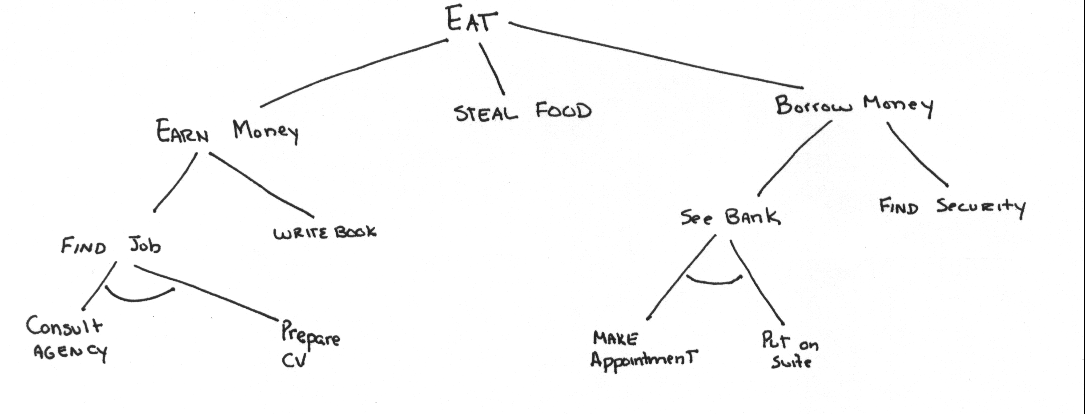
And/Or Trees and Explanations

Slide 66
Explanation Mechanism
Why questions
  answered by considering the predecessor nodes for a given goal or subgoal
How questions
  answered by considering the successor nodes for a given goal or subgoal

Slide 67
Reasoning
Retrospective Reasoning
  Why/how explanations are limited in their power because only focus on local reasoning
Counterfactual Reasoning
  “why not” capabilities
Hypothetical Reasoning
  “what if” capabilities

Slide 68
Causal Models
Can provide expert system designers with information needed to write better explanation systems
“Why” queries can be generated from traversing all related nodes (using E/C links)

Slide 69
Causal Model Links
C/E (cause and effect) links
  broken belt ^{C/E} engine problem
E/C (effect-cause) links
  car won’t start ^{E/C} engine problem
DEF (definitional “isa” inheritance) links
  fuel pump problem ^{DEF} fuel problem
ASSOC (related facts no causality) links
  internal problem ^{ASSOC} cooling problem

Slide 70
Causal Model
car won’t start
E/C E/C
electrical system fuel problem
problem
^{DEF}
^{DEF C/E} fuel pump
no spark problem

Slide 71
Explanation Problems
Rule-bases are composed of “compiled” knowledge
This domain dependent reasoning is then removed when the rules are created
Expert systems rely on the use of domain independent inference strategies

Slide 72
End of Lecture

